Slide 1
Smart Punch Card Reader
Caleb Harper, Dain Hamilton, Diren Gomez, and Andrew Ecoff

Slide 2
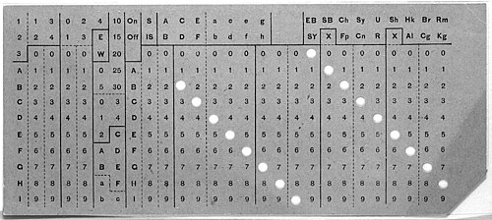
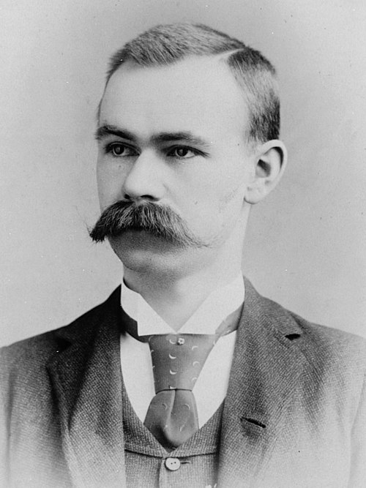
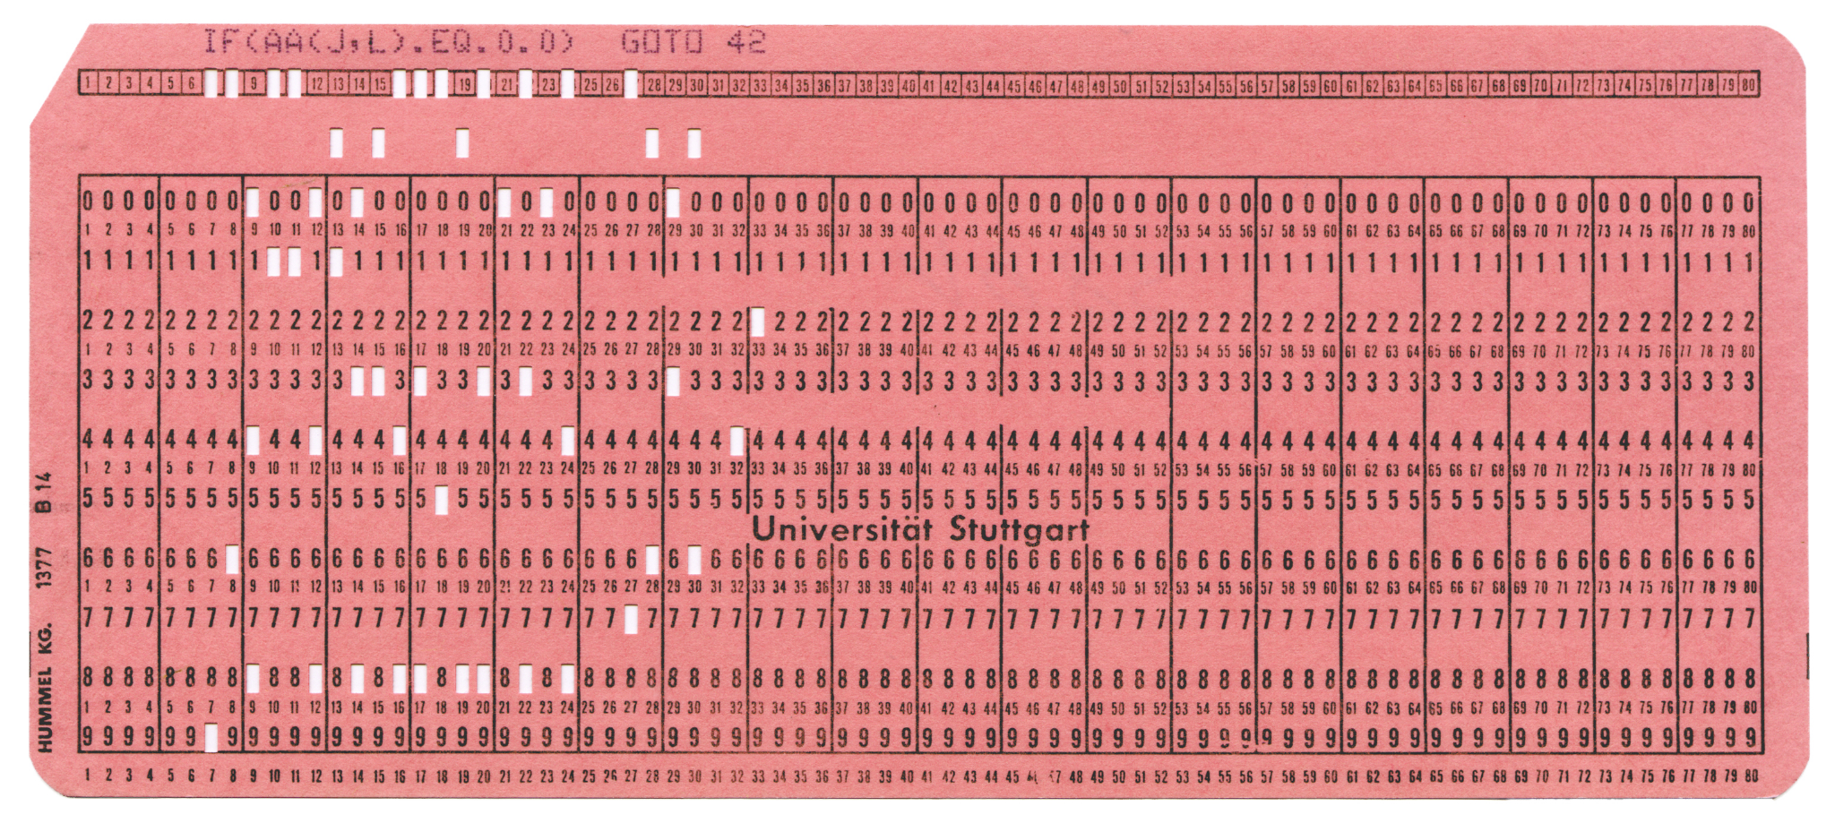
Background on Punch Cards
Used as an early method to program and input data to computers
Most commonly seen with early business oriented languages (COBOL, FORTRAN)
Keypunch machines (Ex. IBM 026) could quickly encode many punch cards
Often included unused data columns for identification (early commenting of sorts)
H. Hollerith (c. 1880) first pioneered punch cards which could be read by machines

Slide 3
Evolution / Design Changes
Paper Grid
Smaller Paper Grid
3D Print
Pogo pins / Wire brushes
Photoresistors with 5v
Photoresistors with 3.3v

Slide 4
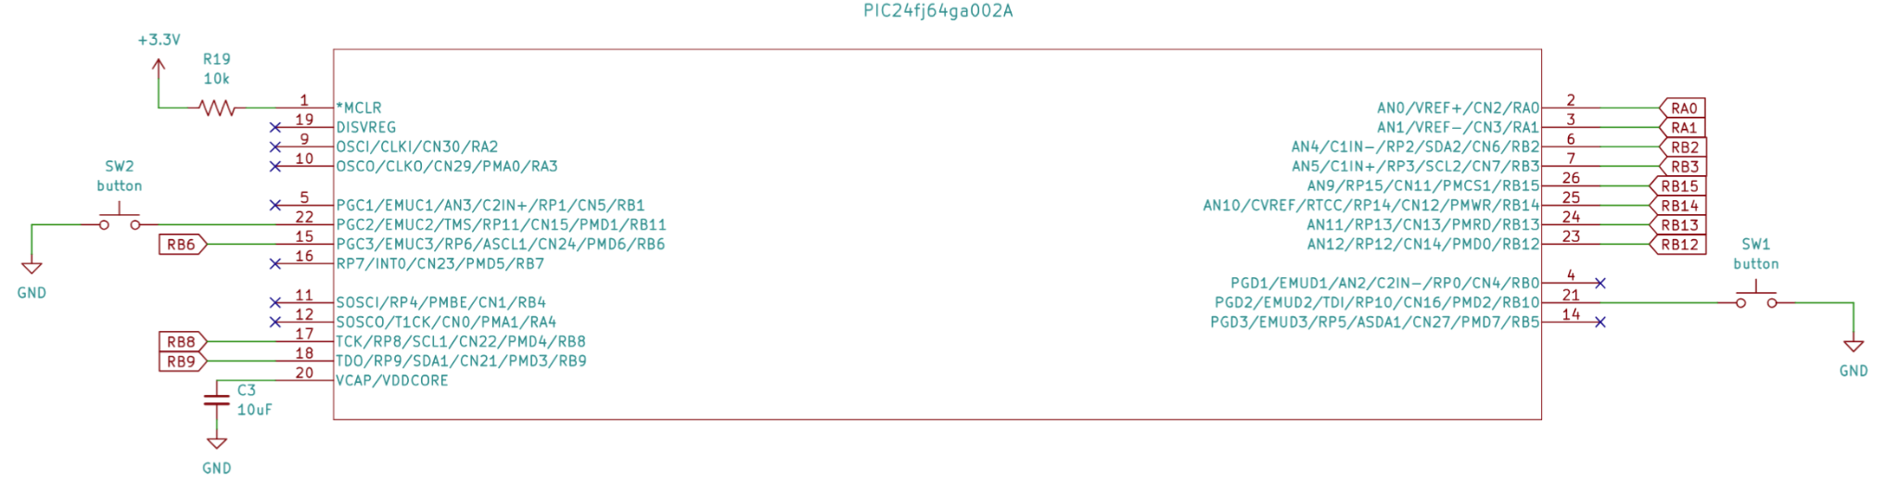
Circuitry: PIC24FJ64GA002
Schematic: Diren

Slide 5
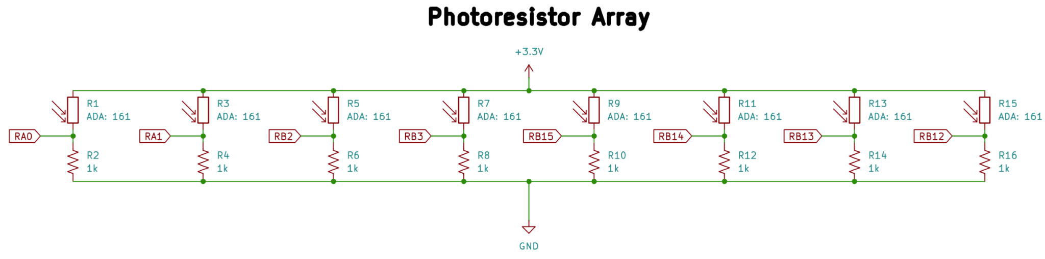
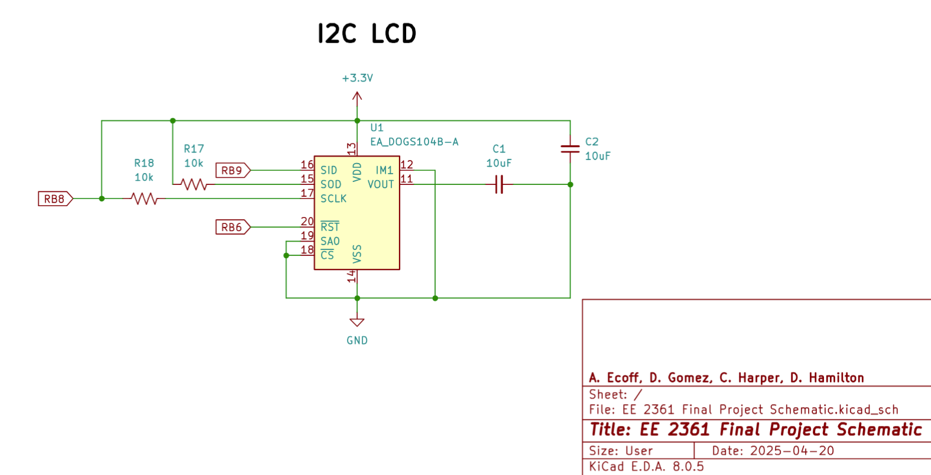
Circuitry:
DOGS104-A
ADA: 161
Wiring: Andrew, Dain Schematic: Diren

Slide 6
Library Support
char read_char(void)
Reads the bits of a character from the photoresistors and returns that character
void read_and_print(void)
Reads a character and prints it out to the LCD
void increment_cursor_pos(void)
Moves the LCD cursor to the next position (right)
void decrement_cursor_pos(void)
Moves the LCD cursor to the previous position (left)
Library: Caleb

Slide 7
read_char() flow
Struct Creation
Assign Values
Return struct
Utilize a C union type to alias 8 individually addressable bits to a single character
Read the photoresistor values to assign each bit
Return the character from the union type, which is created from the individual bits with minimal effort

Slide 8
General Operation
Wait for Button
Read Character
Print and Return Idle
Continuously polls the button to see whether it should delete the previous character or proceed to read the next character
Record binary values from each of the photoresistor voltage dividers
Store and package them through aforementioned process
Prints the correct value to the LCD and then returns to waiting for the button to be pressed

Slide 9
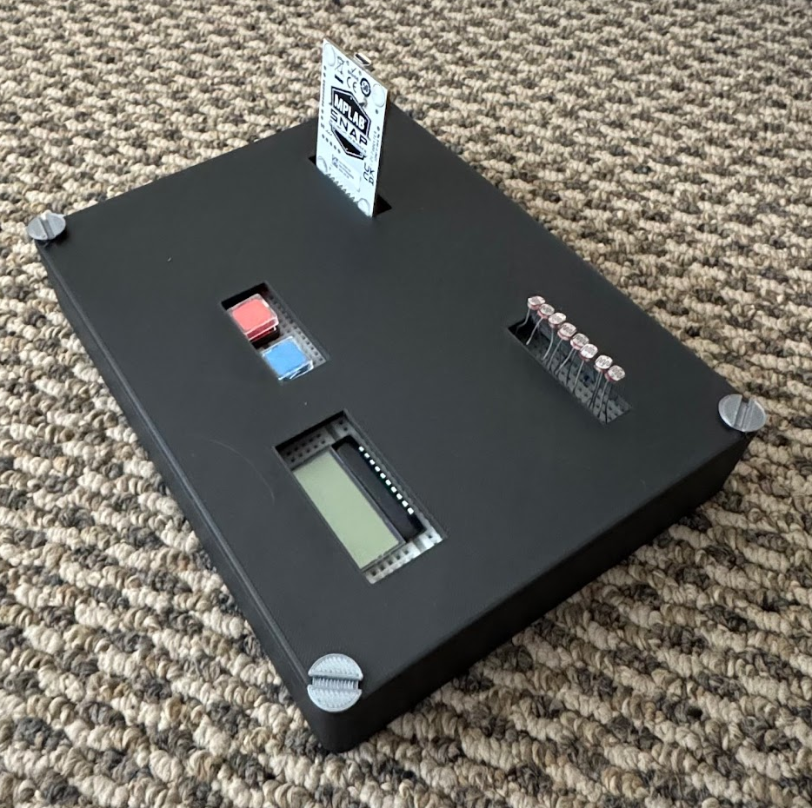
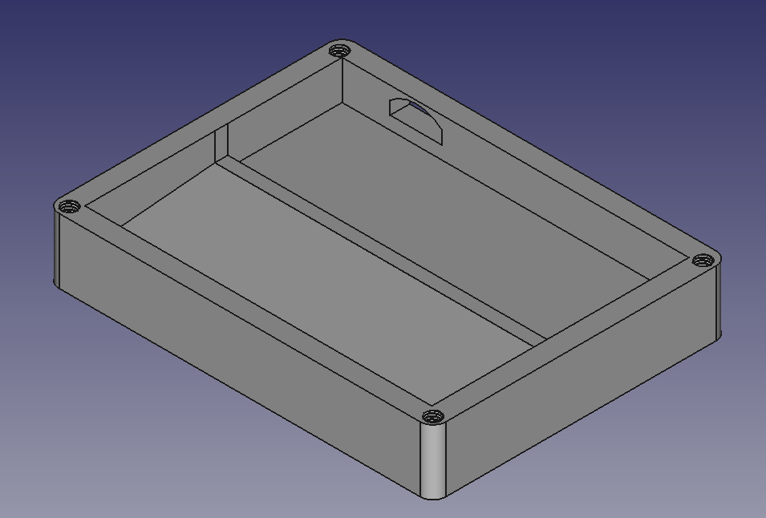
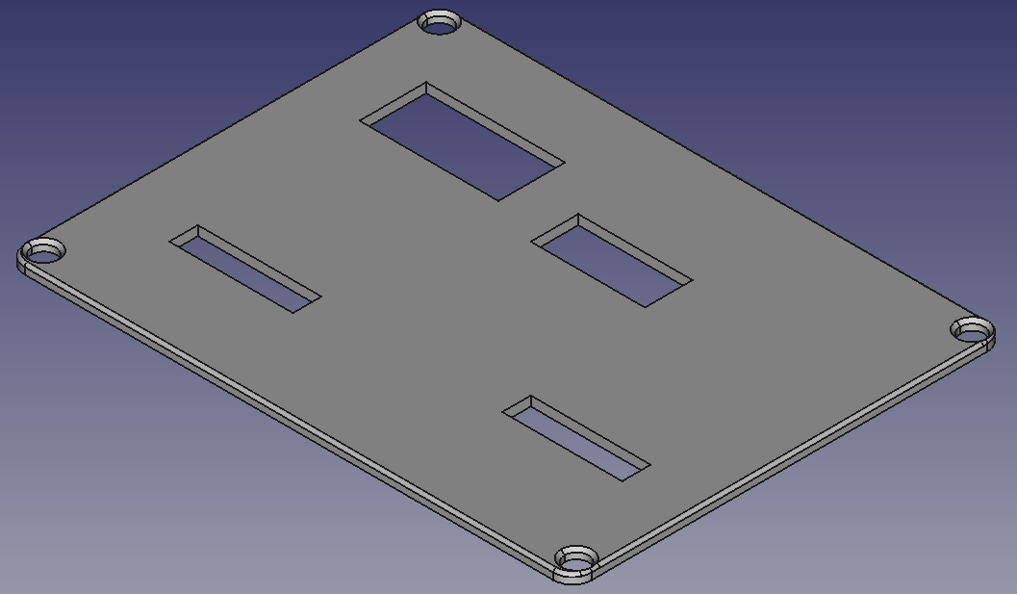
Final Product
Housing: Andrew
Hardware Prototyping: Dain

Slide 10
Further Considerations and Limitations
The circuit doesn’t utilize ADC’s which mean that the reader cannot be tuned to its environment. More luminous environments will behave differently to dim environments.
Circumnavigate peripheral limit via multiplexing and transistor logic / polling
Further exploration, utilization of larger punch cards through this multiplexing system

Slide 11
Questions?

